Slide 1
DEVELOPMENT OF A FACE DETECTION SYSTEM USING OPENCV AND CYCLONE V HYBRID ARM AND FGPA SYSTEM ON A CHIP
REGALADO, GIL MICHAEL

Slide 2
Background of the Study
Human Vision
Important sensory ability
Highest information density
Filter out noise focus on objects of interest

Slide 3
Background of the Study
Artificial Vision
Inspired by nature
visual search applications
Computer Vision
Collection of theory
Obtain information from images
Applied in a wide array of Industries

Slide 4
Background of the Study
Implementation of Computer Vision
Hardware
Compute capability
Software
Efficiency of Algorithms

Slide 5
Background of the Study
OpenCV
Computer Vision Library
Berkeley Software Distribution (BSD) license
Open Source
Intel Research initiative
Intel Russia
Intel’s Performance Library Team

Slide 6
Background of the Study
OpenCV Goals
Advance vision research
Provide open source technology
Optimized code for basic vision infrastructure
Avoiding reinventing the wheel
Integrated Performance Primitives routines to accelerate OpenCV on Intel based processors
Purchase of license
Academic free version

Slide 7
Background of the Study
Competition
ARM architecture
Reduced Instruction Set Computing
ARM Holdings
IP Core business

Slide 8
Background of the Study
RISC
Significant reduction of transistors
Lower cost
Lower operating temperature
Lower power requirements

Slide 9
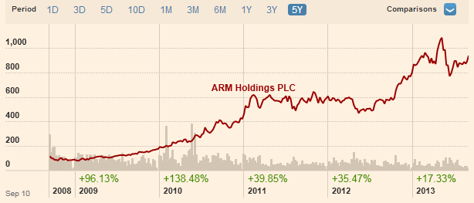
Background of the Study
5 Year period growth
http://markets.ft.com/research/Markets/Tearsheets/Summary?s=ARM:LSE

Slide 10
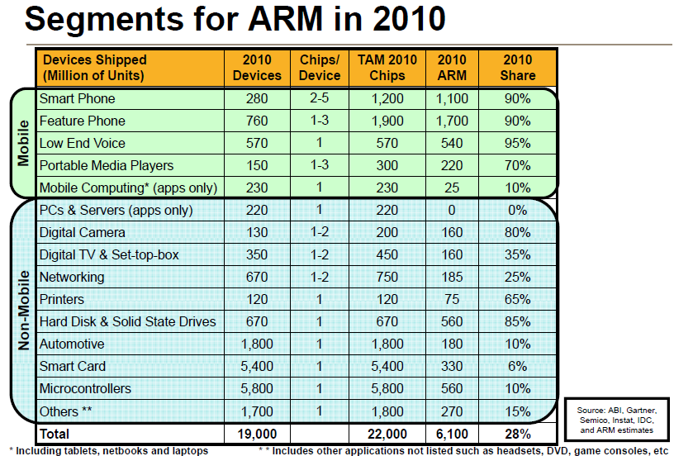

Slide 11
Background of the Study
SoC – System on a Chip
integrates all components of a computer
contain digital, analog, mixed-signal and often radio-frequency functions integrated in one single chip substrate
FPGA
verification of hardware, firmware and software design

Slide 12
Background of the Study
FPGA Cons
General-purpose CPU’s are generally faster for sequential operations
FPGA Pros
Massively parallel operations

Slide 13
Background of the Study
OpenCV
Most operations are parallel
High Bandwidth Operations
Images could be large
Video frame/sec could be high
Operations/Frame a lot

Slide 14
Background of the Study
Zynq-7000 (4th Qtr 2011)
dual ARM Cortex-A9 MPCore
low-power programmable logic
hardened peripheral IP

Slide 15
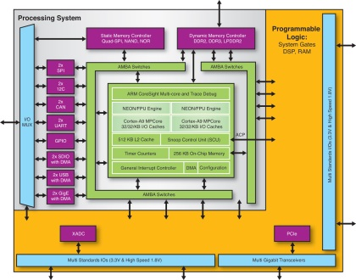

Slide 16
Background of the Study
SocKit 5CSXFC6D6F31C8NES IC (Sept, 2013)
FPGA
Cyclone V
110K LEs, 41509 ALMs
1GB (2x256MBx16) DDR3 SDRAM on FPGA
ARM Hard Processor Core (HPS)
800 MHz, A Dual-Core ARM Cortex™-A9 MPCore™ Processor
1GB (2x256MBx16) DDR3 SDRAM on HPS

Slide 17
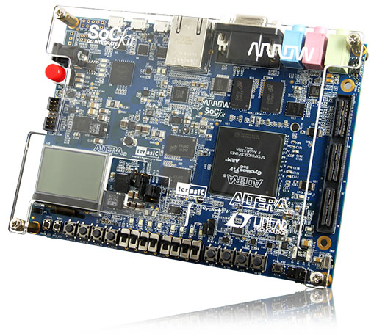

Slide 18
Background of the Study
Challenges Before
CPU Workbench Very expensive
FPGA Workbench Very expensive
CPU and FPGA Interconnect Difficult
Separate boards for CPU and FPGA
Single board Solutions
Still expensive

Slide 19
Background of the Study
Benefits of CPU+FPGA SoC
CPU + FPGA Single Chip Solution
ARM CPU Drives Down Cost
Custom FPGA Logic + CPU now have lower cost
Developer tools available because both are from the same manufacturer
Allows for Development of CPU+FPGA Solutions at lower cost
OpenCV Acceleration

Slide 20
Statement of the Problem
OpenCV
Prevalent on CISC based CPU’s
Headed by Intel
ARM Support of OpenCV
Young
ARM + FPGA Support Very New
This research focuses on Develop ARM+FPGA Support of OpenCV

Slide 21
Objectives of the Study
to develop the Hardware and Software Integration system required to run Linux on the CycloneV SoC SoCKit Development Board;
to develop a custom version of the Linux Open Source Operating System that will be compatible with the system CycloneV SoC SoCKit Development Board;
to compile and install the OpenCV library on to the Linux System;

Slide 22
Objectives of the Study
to develop the Face Detection System using the Installed OpenCV Library;
and to compare the performance parameters of the Face Detection system on an CISC Intel based platform.

Slide 23
Significance of the Study
Allowing the OpenCV Library to run on a Hybrid ARM and FPGA hardware
Future potential for hardware acceleration

Slide 24
Scope and Limitations
Only the SoCKit Cyclone V Development Board
Limited set of peripherals
Limited Input Image Devices

Slide 25
Conceptual Framework

Slide 26
Hardware
Now for SoCKit Development Board

Slide 27
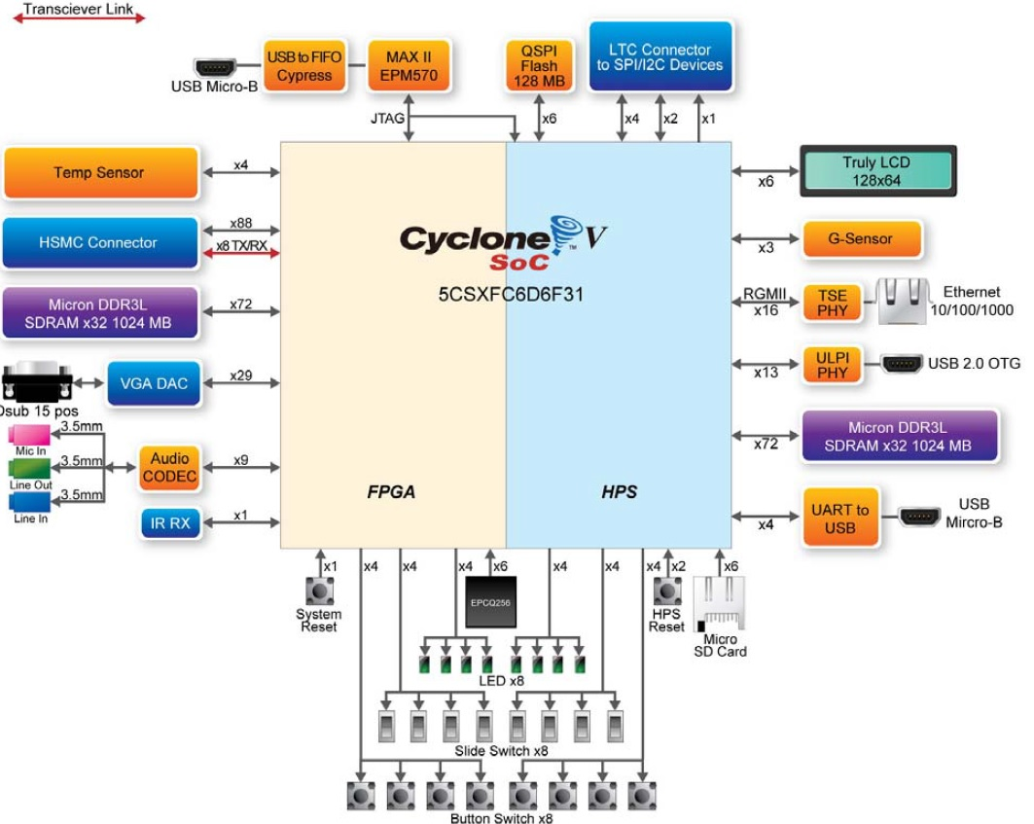
Conceptual Framework
hardware

Slide 28
Conceptual Framework
hardware

Slide 29
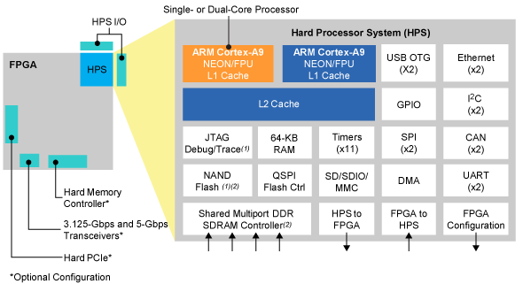
Conceptual Framework
hardware

Slide 30
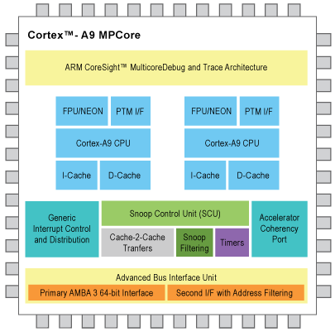
Conceptual Framework
hardware

Slide 31
Conceptual Framework
hardware

Slide 32
Conceptual Framework (SOFTWARE)
In-system
Inside the Board
OpenCV Library
SSH
Synergy
More…
Development Software
Used to develop system
Software

Slide 33
Development Software

Slide 34
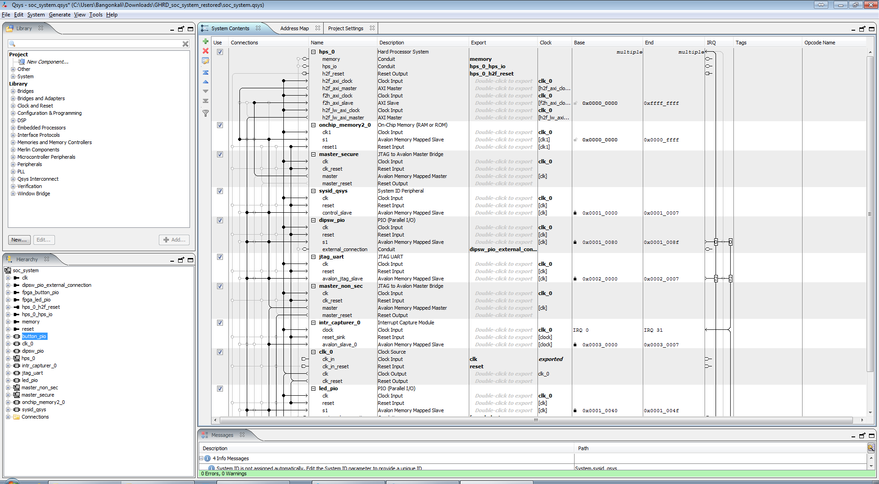
Development Software

Slide 35
PROJECT DESIGN AND METHODOLOGY

Slide 36
PROJECT DESIGN AND METHODOLOGY

Slide 37
PROJECT DESIGN AND METHODOLOGY

Slide 38
PROJECT DESIGN AND METHODOLOGY

Slide 39
PROJECT DESIGN AND METHODOLOGY

Slide 40
PROJECT DESIGN AND METHODOLOGY

Slide 41
PROJECT DESIGN AND METHODOLOGY

Slide 42
PROJECT DESIGN AND METHODOLOGY
Integration Layer

Slide 43
PROJECT DESIGN AND METHODOLOGY

Slide 44
PROJECT DESIGN AND METHODOLOGY
Integration Layer

Slide 45
PROJECT DESIGN AND METHODOLOGY

Slide 46
PROJECT DESIGN AND METHODOLOGY
Integration Layer

Slide 47
PROJECT DESIGN AND METHODOLOGY

Slide 48
PROJECT DESIGN AND METHODOLOGY

Slide 49
PROJECT DESIGN AND METHODOLOGY

Slide 50
PROJECT DESIGN AND METHODOLOGY

Slide 51
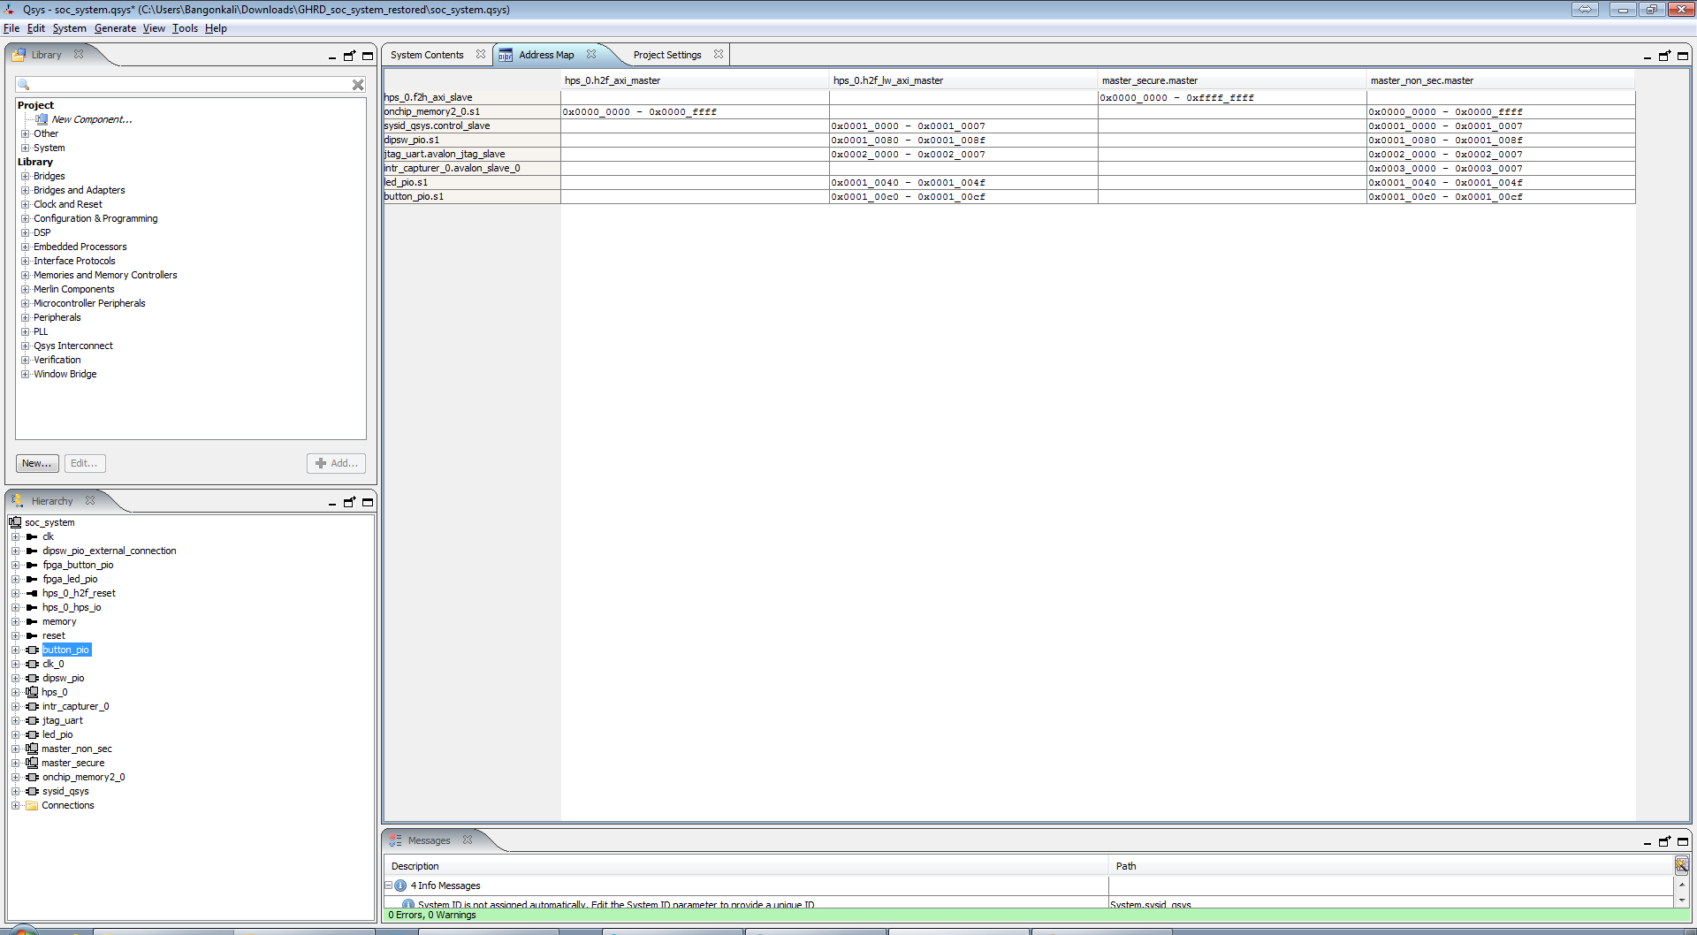
Address Mapping of Devices to CPU

Slide 52
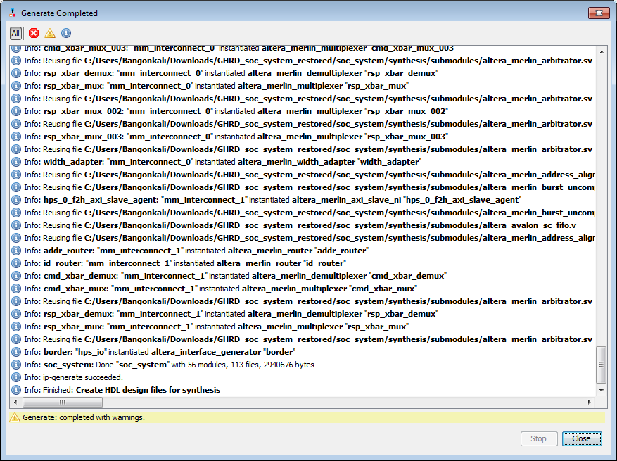
Generation of Verilog Files

Slide 53
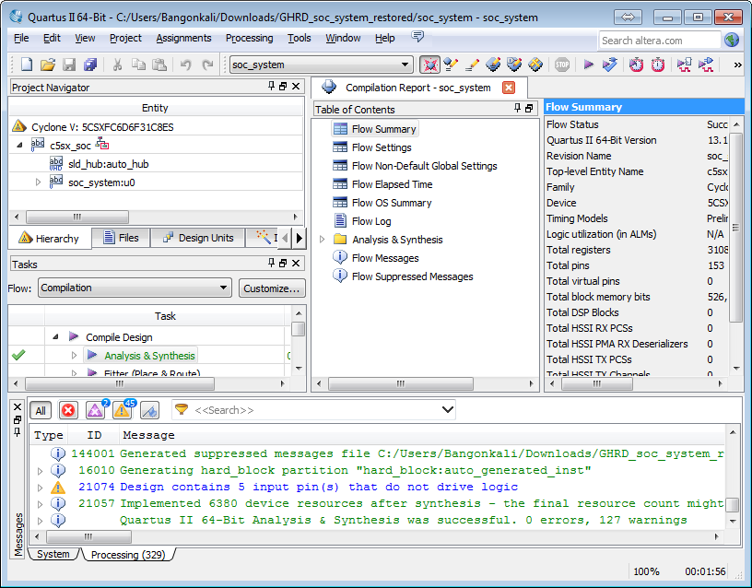
PROJECT DESIGN AND METHODOLOGY

Slide 54
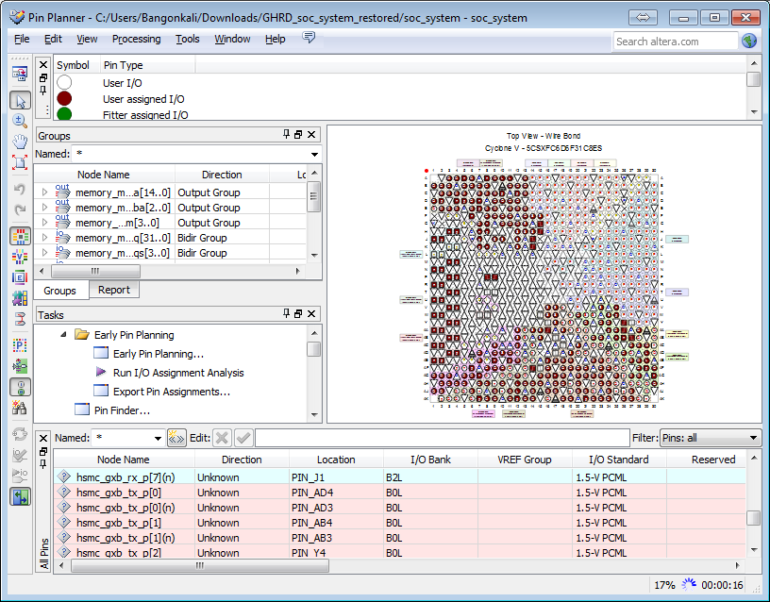
PIN ASSIGNMENTS

Slide 55
PROJECT DESIGN AND METHODOLOGY
OUTPUT:
FPGA RBF – FPGA Raw Binary File

Slide 56
PROJECT DESIGN AND METHODOLOGY

Slide 57
PROJECT DESIGN AND METHODOLOGY
USE: Altera’s BSP Editor
DTB - Device Tree (Used for Linux Later)
Preloader

Slide 58
PROJECT DESIGN AND METHODOLOGY

Slide 59
PROJECT DESIGN AND METHODOLOGY
Linaro Toolchain
Generates UIMAGE and Compiled DTB
Kernel Image
Kernel Modules
Used for USB Video Class(UVC)
Clone Altera’s Modified Linux
Modify Altera’s Modified Linux

Slide 60
PROJECT DESIGN AND METHODOLOGY

Slide 61
PROJECT DESIGN AND METHODOLOGY
Install
UI (Debian based Linaro Ubuntu)
Network Utilities (SSH)
Mouse & Keyboard (Synergy)
Compiler (GCC/MAKE)
OpenCV Libraries

Slide 62
PROJECT DESIGN AND METHODOLOGY
Modify Face Detection Sample for Test Case
Compare results with CISC Implementation

Slide 63
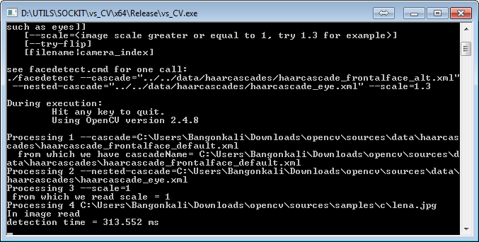
Results (CISC)

Slide 64
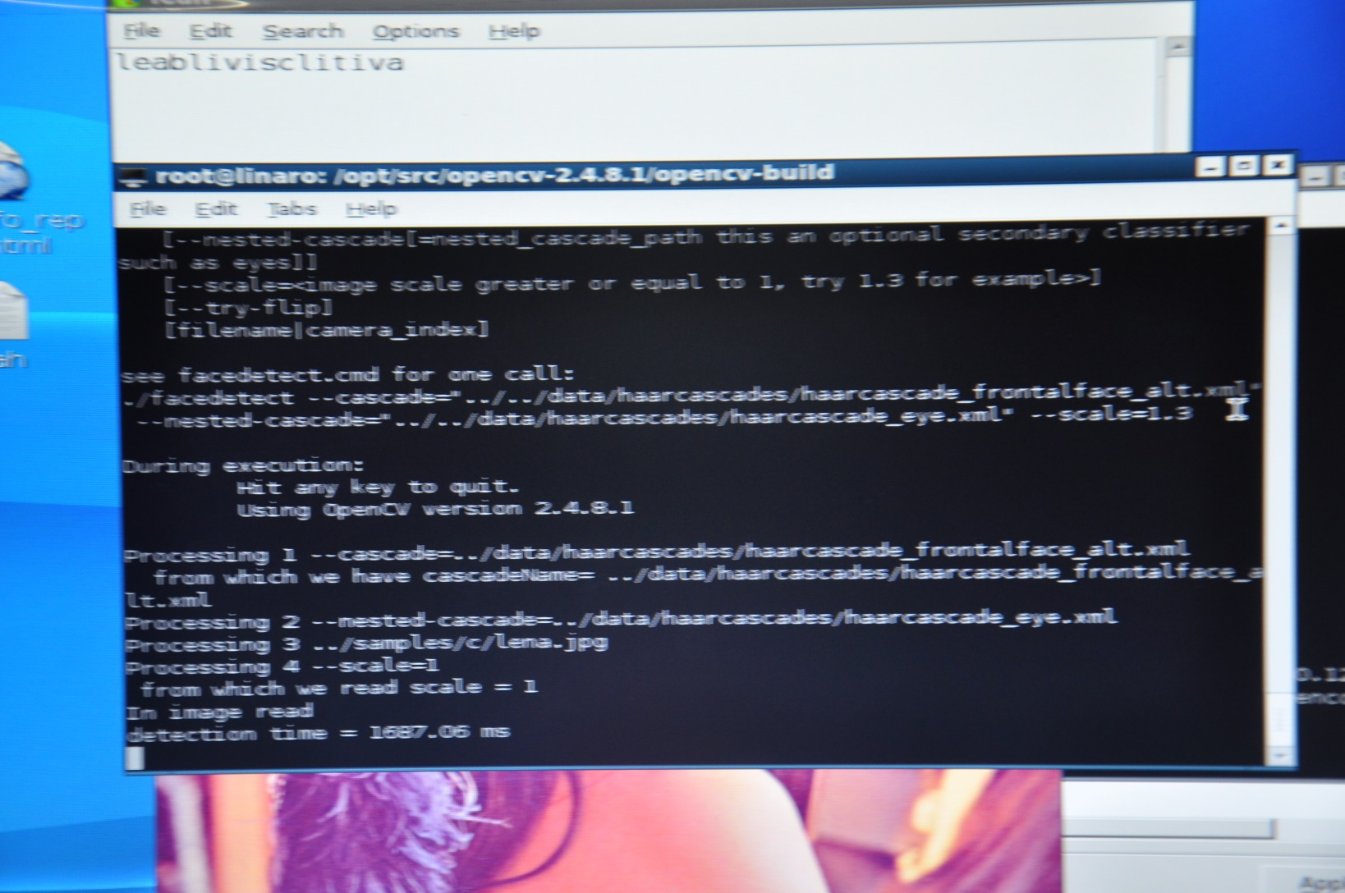
Results (SoCKit)

Slide 65
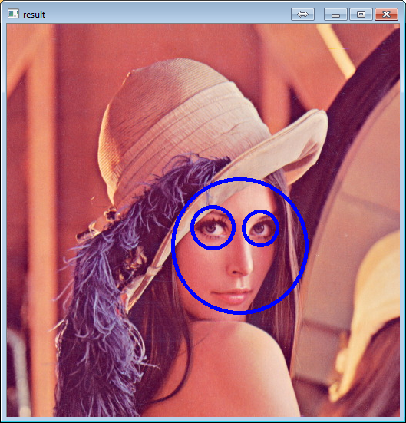
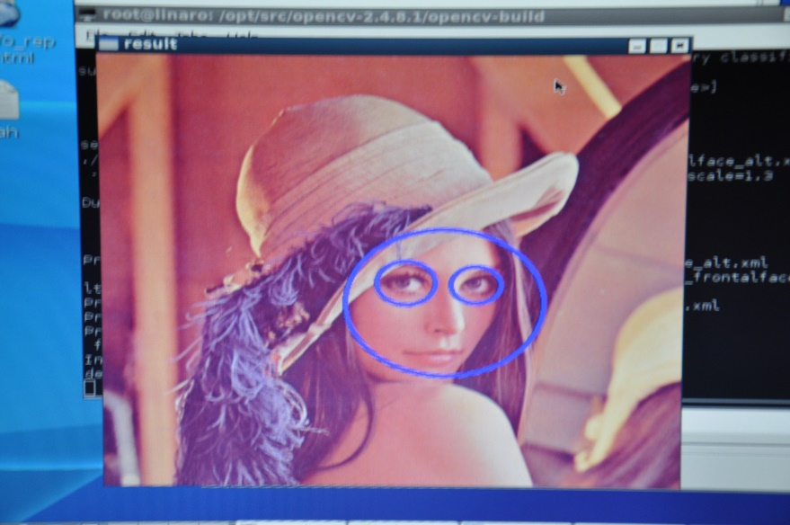
Results
1687ms
313ms
Difference: 43%

Slide 66
Conclusion
SoCKit is able to Support:
Hardware + Software Integration
Linux
OpenCV
Face Detection
Needs more:
Patches/Fixes

Slide 67
Recommendation
A Linux Environment including Kernel and GUI that is fully compatible with the SoCKit System and with the additional fixes of the issues encountered especially in UVC.
Adding the sound support for the Linux System. Future implementation may then support both Face and Audio Recognition.
Hardware Acceleration using FPGA component of the SoCKit for various algorithms that are involved in the OpenCV Library and various other libraries.

Slide 68
Questions

